Slide 1
Mercury
Intro to Astrophysics
James Carroll
Elon University

Slide 3
Craters
Craters are formed when planetesimals (comets or asteroids) collide with planets.
Planetesimals typically have a speed of 40,000 to 250,000 km/hr.
When planetesimals collide with a planet, they vaporize solid rock creating a crater.

Slide 4
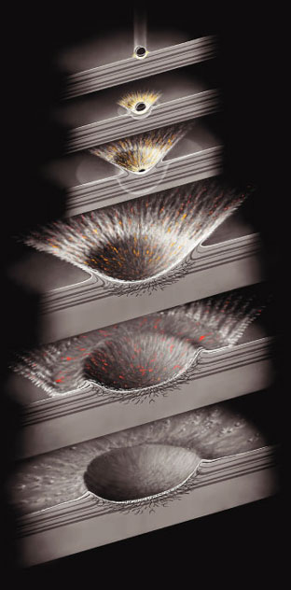

Slide 6
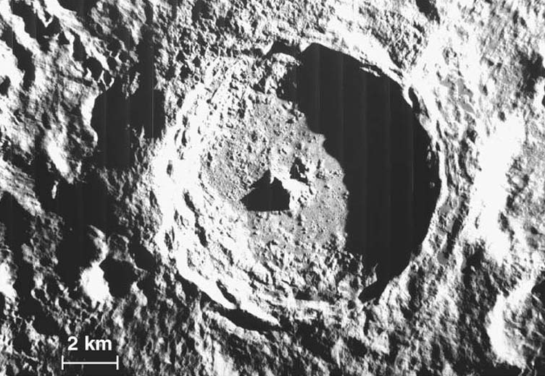
THE MOON

Slide 8
MARS

Slide 9
Crater Characteristics
Craters are 10 times wider than the impacting planetesimal.
Craters are 10 – 20% deep as they are wide
Approximately how deep would a crater caused by a planetesimal with a 10km diameter be?
10 km x 10 = 100 km wide
15% x 100 km = 15 km deep

Slide 10
Caloris Basin

Slide 12
Questions
Why does Mercury have craters while the Earth does not?
How can we use the presence of craters to tell more about Mercury?

Slide 13
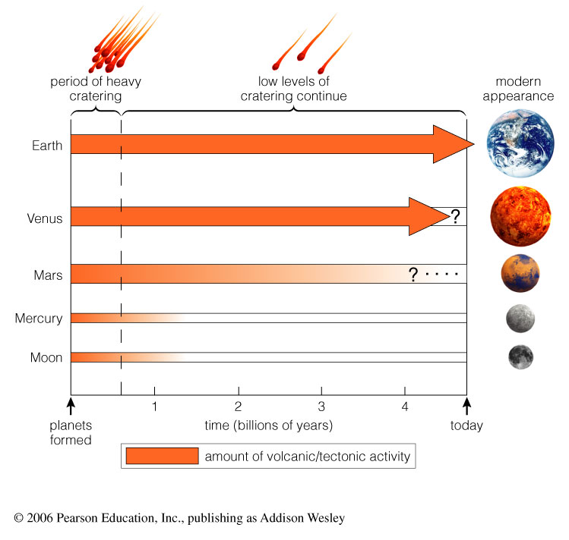

Slide 14
Geological Activity
Looking at smaller planets we see:
Interior cools rapidly
Tectonic and volcanic activity ceases after a billion years
Molten flows onto surface and covers up craters.
With less geological activity the craters remain.

Slide 15
THE MOON

Slide 16
Cliffs or Lobate Scarps
Heat due to accretion and differentiation swelled the size of the core.
As Mercury cooled, the core contracted an estimated 20km.
The shrinking core pulled the lithosphere with it.

Slide 17
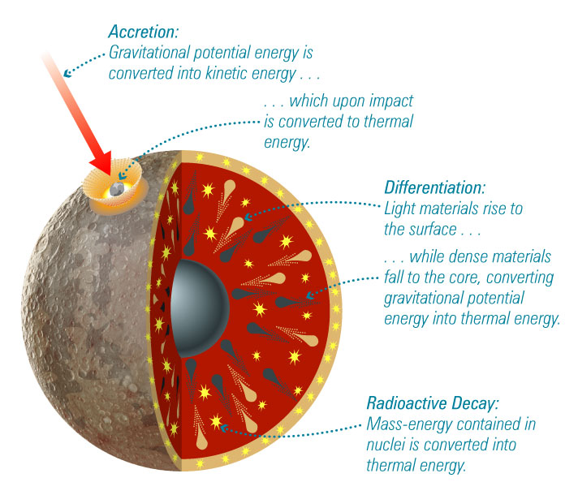

Slide 18
Cliffs or Lobate Scarps
Heat due to accretion and differentiation swelled the size of the core.
As Mercury cooled, the core contracted an estimated 20km.
The shrinking core pulled the lithosphere with it.
Heat due to accretion and differentiation swelled the size of the core.
As Mercury cooled, the core contracted an estimated 20km.
The shrinking core pulled the lithosphere with it.

Slide 19
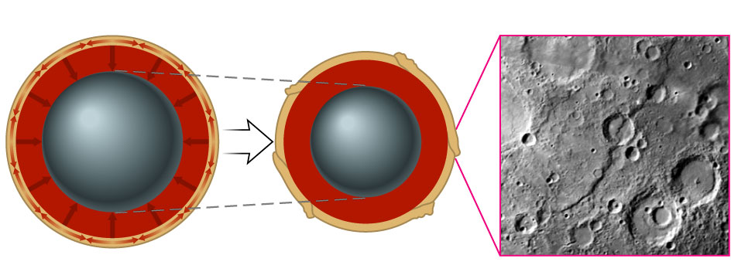

Slide 20
Early Theories
The perihelion precession of Mercury could not be defined by Newtonian Laws.
Le Verrier (French Mathematician)
He suggested the planet Vulcan caused this increased precession in Mercury’s orbit.
Le Verrier gained many followers due to his work discovering Neptune.

Slide 21
Early Theories
Einstein’s theory of relativity provided accurate calculations for Mercury’s precession.
He proved Mercury’s orbit aligned with the curvature of space-time.

Slide 22
Early Theories
Giovanni Schiaparelli concluded Mercury was tidally coupled to the Sun.
In 1962, radio astronomers discovered 3-to-2 coupling.

Slide 25
Current Theories
Mercury’s magnetic field is 100 times less than Earth’s magnetic field.
Remains confusion around Mercury’s magnetic field.

Slide 26
Magnetic Field
3 Basic Requirements for Magnetic Field:
Electrically conducting fluid such as molten metal within the planet.
Occurrence of convection in that layer of fluid.
Moderately rapid rotation

Slide 28
Magnetic Field Recap
The slow rotation would contradict existence of magnetic field.
Mercury’s small size means core should have cooled. Therefore, there is no convecting molten to generate a field.

Slide 29
Current Theories
Magnetic field is due to Mercury’s abnormally large metal core.
“Frozen-in” – From a time when the planet was warmer and rotated faster.

Slide 30
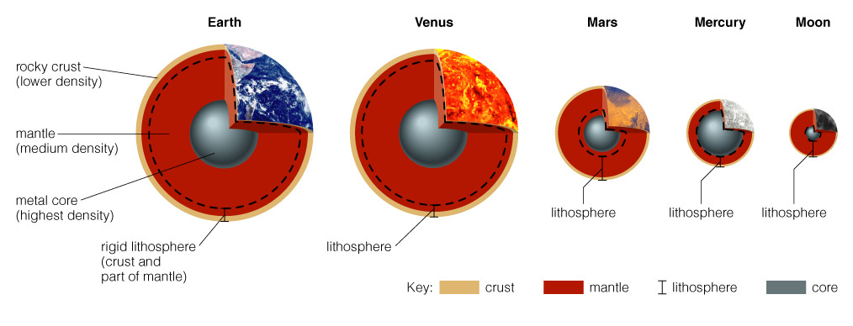

Slide 31
Atmosphere
Existing atmosphere from solar winds trapped by magnetic field.
Very little atmosphere on Mercury
Weak Magnetic Field
Hot temperatures due to proximity to Sun
With low escape velocity and high temperatures gases easily escape atmosphere

Slide 32
Temperatures
Fluxuate from 825K on solar side to 176-60K in shadows.
No gases to transport heat across the planet
Water ice at the poles because almost no sunlight reaches them.

